Slide 1
G2 Ocean
The Paper Bill of Lading is ready for retirement
Blockchain technology future impact on trade and shipping

Slide 2
G2 OCEAN AT A GLANCE
6 continents
15 offices
27 trade routes
130 vessels
90 Open Hatch
40 conventional bulk
330 employees
Turnover 1,3 Billion USD (2018)

Slide 3
BLOCKCHAIN - EXPLAINED

Slide 4
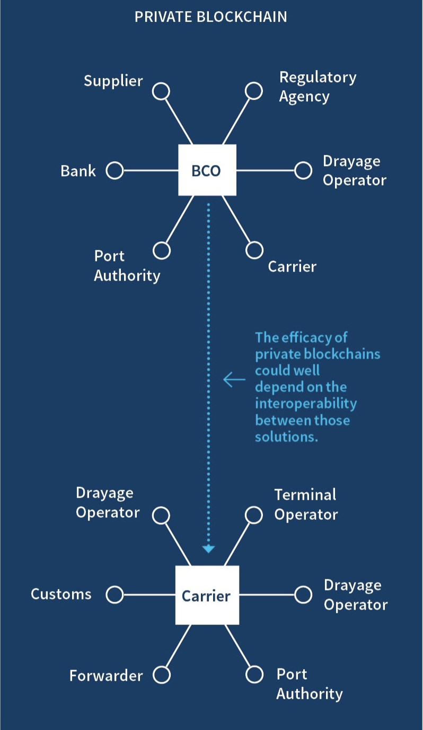
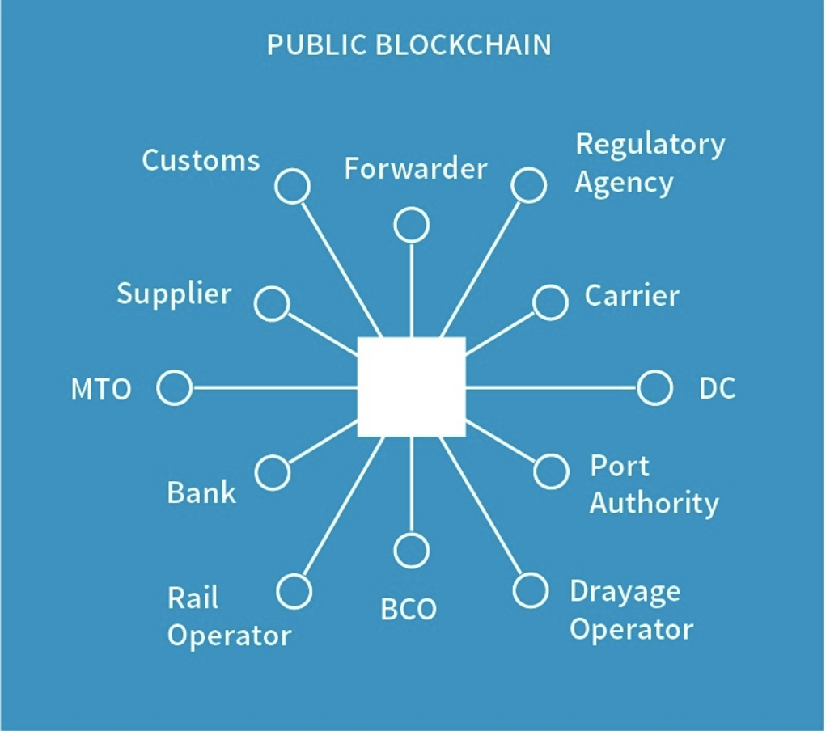
BLOCK CHAIN - EXPLAINED
Source: IHS Markit

Slide 5
BLOCKCHAIN PILOT – DIGITAL ISSUING AND DISTRIBUTION OF BILL OF LADING
Various platforms / solutions evaluated - CargoX platform chosen for the pilot
The CargoX platform is a web based platform, using the Ethereum Smart Contract Plaform (Public Blockchain)
G2 Ocean and CargoX currently in process with the international P&I Clubs for approval of blockchain based digital Bill of Lading.
Pilot with three major global accounts with start up March 2019
Notes:
In G2 Ocean we are committed to being a sustainable, pioneering and responsible company. We will support our owners, Gearbulk and Grieg Star, ongoing commitment to the environment, people and the positive economic impact that a company can have. We want to build on the heritage that both Gearbulk and Grieg Star have and at the same time look at new ways of doing business.
Having only been in operation since May 2017 we have to look at how we can work together with our stakeholders in protecting the environment, ensuring that we treat all those who both work with and for G2 Ocean fairly and responsibly and also ensuring that G2 Ocean will be economically secure for now and the future.
Over the next few months we will be developing our Corporate Social Responsibility policies based on the UN Global Compact principles and ensuring that they are embedded in the way we conduct business and thus our corporate culture.

Slide 6
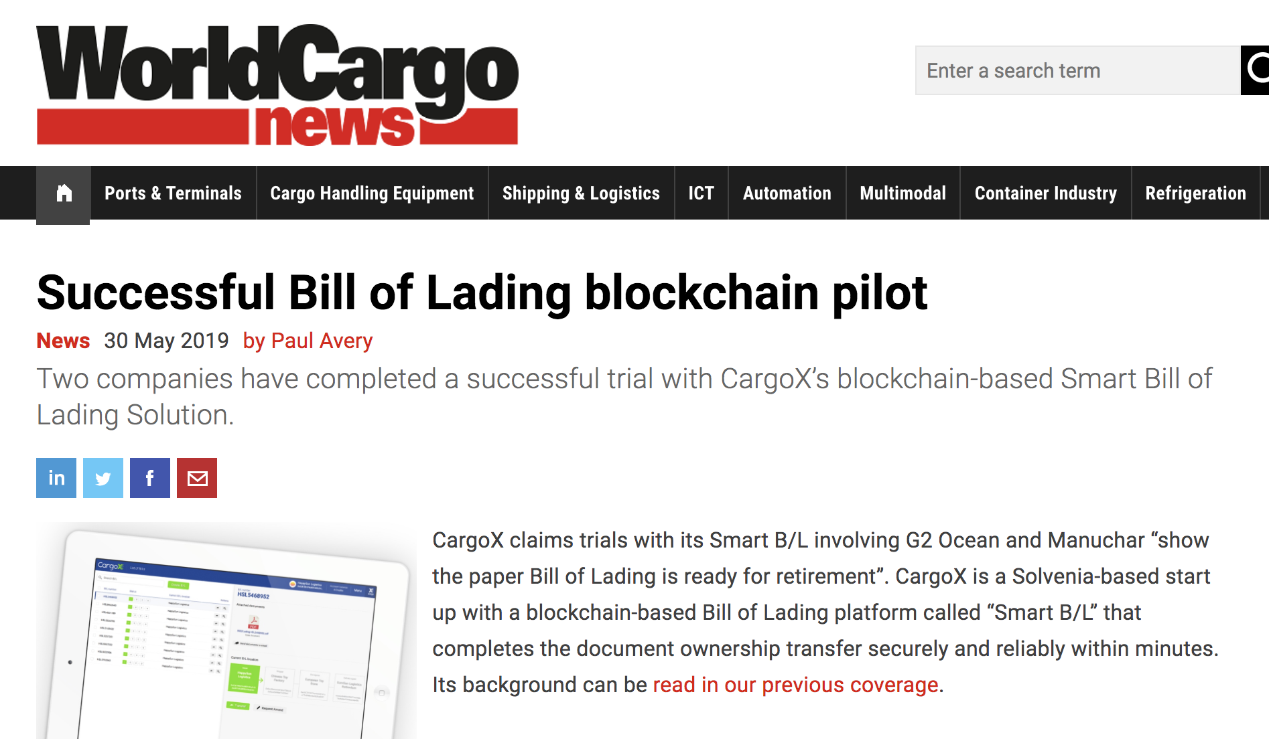
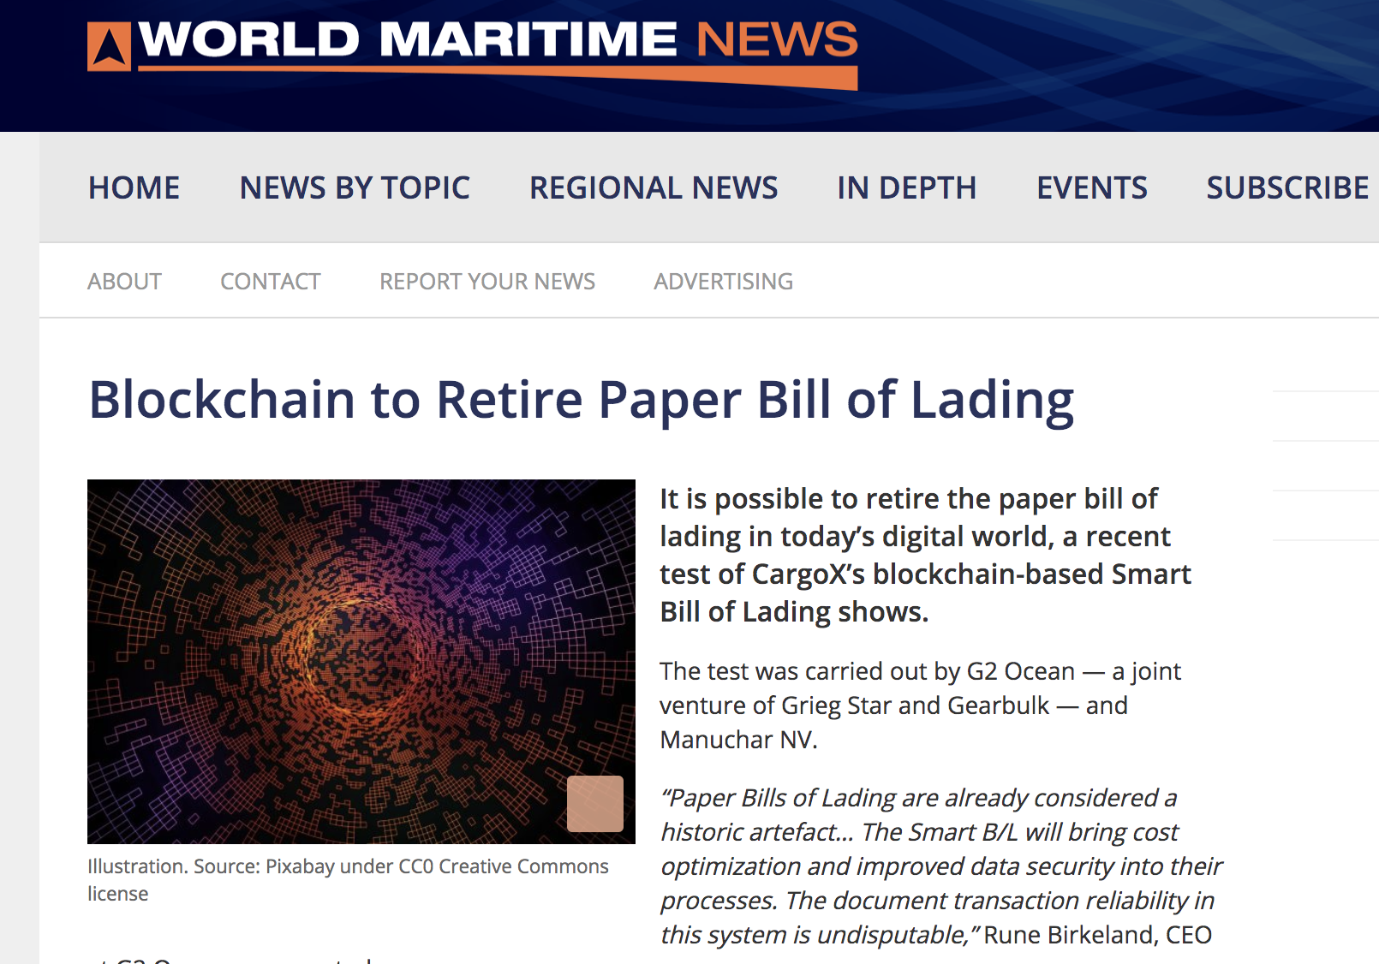
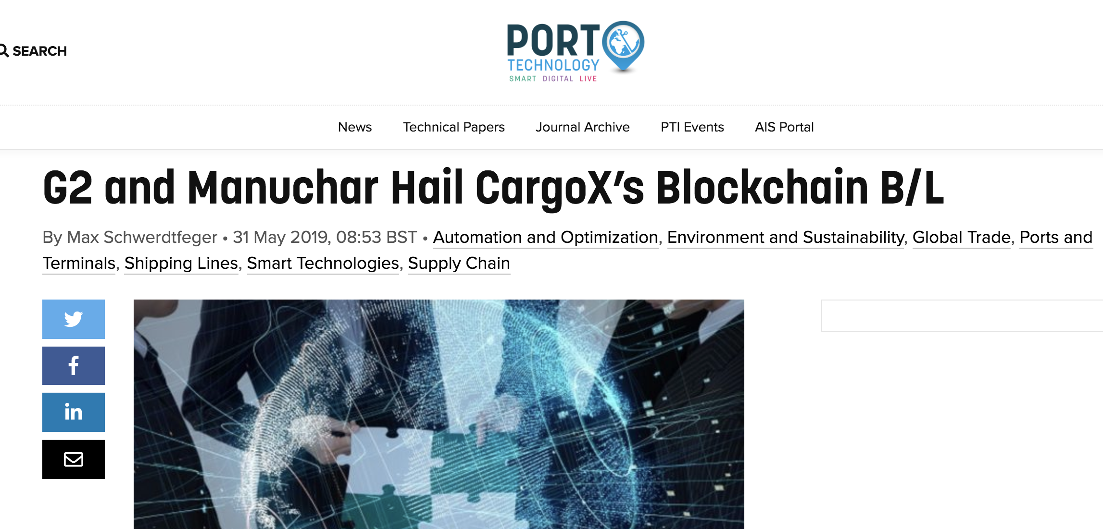
BLOCKCHAIN PILOT – DIGITAL ISSUING AND DISTRIBUTION OF BILL OF LADING
Notes:
In G2 Ocean we are committed to being a sustainable, pioneering and responsible company. We will support our owners, Gearbulk and Grieg Star, ongoing commitment to the environment, people and the positive economic impact that a company can have. We want to build on the heritage that both Gearbulk and Grieg Star have and at the same time look at new ways of doing business.
Having only been in operation since May 2017 we have to look at how we can work together with our stakeholders in protecting the environment, ensuring that we treat all those who both work with and for G2 Ocean fairly and responsibly and also ensuring that G2 Ocean will be economically secure for now and the future.
Over the next few months we will be developing our Corporate Social Responsibility policies based on the UN Global Compact principles and ensuring that they are embedded in the way we conduct business and thus our corporate culture.

Slide 7
Notes:
The numbers are GB and GS combined 2016. Will provide G2 Ocean numbers when we have been operating long enough to have reliable numbers.

Slide 8
Notes:
The numbers are GB and GS combined 2016. Will provide G2 Ocean numbers when we have been operating long enough to have reliable numbers.

Slide 9
BLOCKCHAIN PILOT – EXPERIENCE
Pro´s
Very efficient and user friendly, and represents a unique opportunity for digitalization of the flow of original / negotiable B/L´s and L/Cs.
Eliminate delays and risk for loss of documents / Letter of Indemnity. As carrier we have full visibility who has the original digital documents in their custody.
Cost savings through elimination of manual tasks and elimination of courier shipments.
Con´s
Blockchain is still a new technology, and customers, customs authorities, ships agents all struggle to understand the technology, and the meaning of “digital original” Bill of Lading. It will take time and a lot of “education” to get rid of the requirement of “wet” ink and stamps on printed documents in countries like Brazil ++
Understanding / approval from P&I Club´s is slow. Good support from the P&I clubs so far, but so far only one Blockchain based B/L is approved by the P&I Clubs.
Notes:
In G2 Ocean we are committed to being a sustainable, pioneering and responsible company. We will support our owners, Gearbulk and Grieg Star, ongoing commitment to the environment, people and the positive economic impact that a company can have. We want to build on the heritage that both Gearbulk and Grieg Star have and at the same time look at new ways of doing business.
Having only been in operation since May 2017 we have to look at how we can work together with our stakeholders in protecting the environment, ensuring that we treat all those who both work with and for G2 Ocean fairly and responsibly and also ensuring that G2 Ocean will be economically secure for now and the future.
Over the next few months we will be developing our Corporate Social Responsibility policies based on the UN Global Compact principles and ensuring that they are embedded in the way we conduct business and thus our corporate culture.

Slide 10
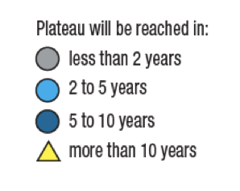
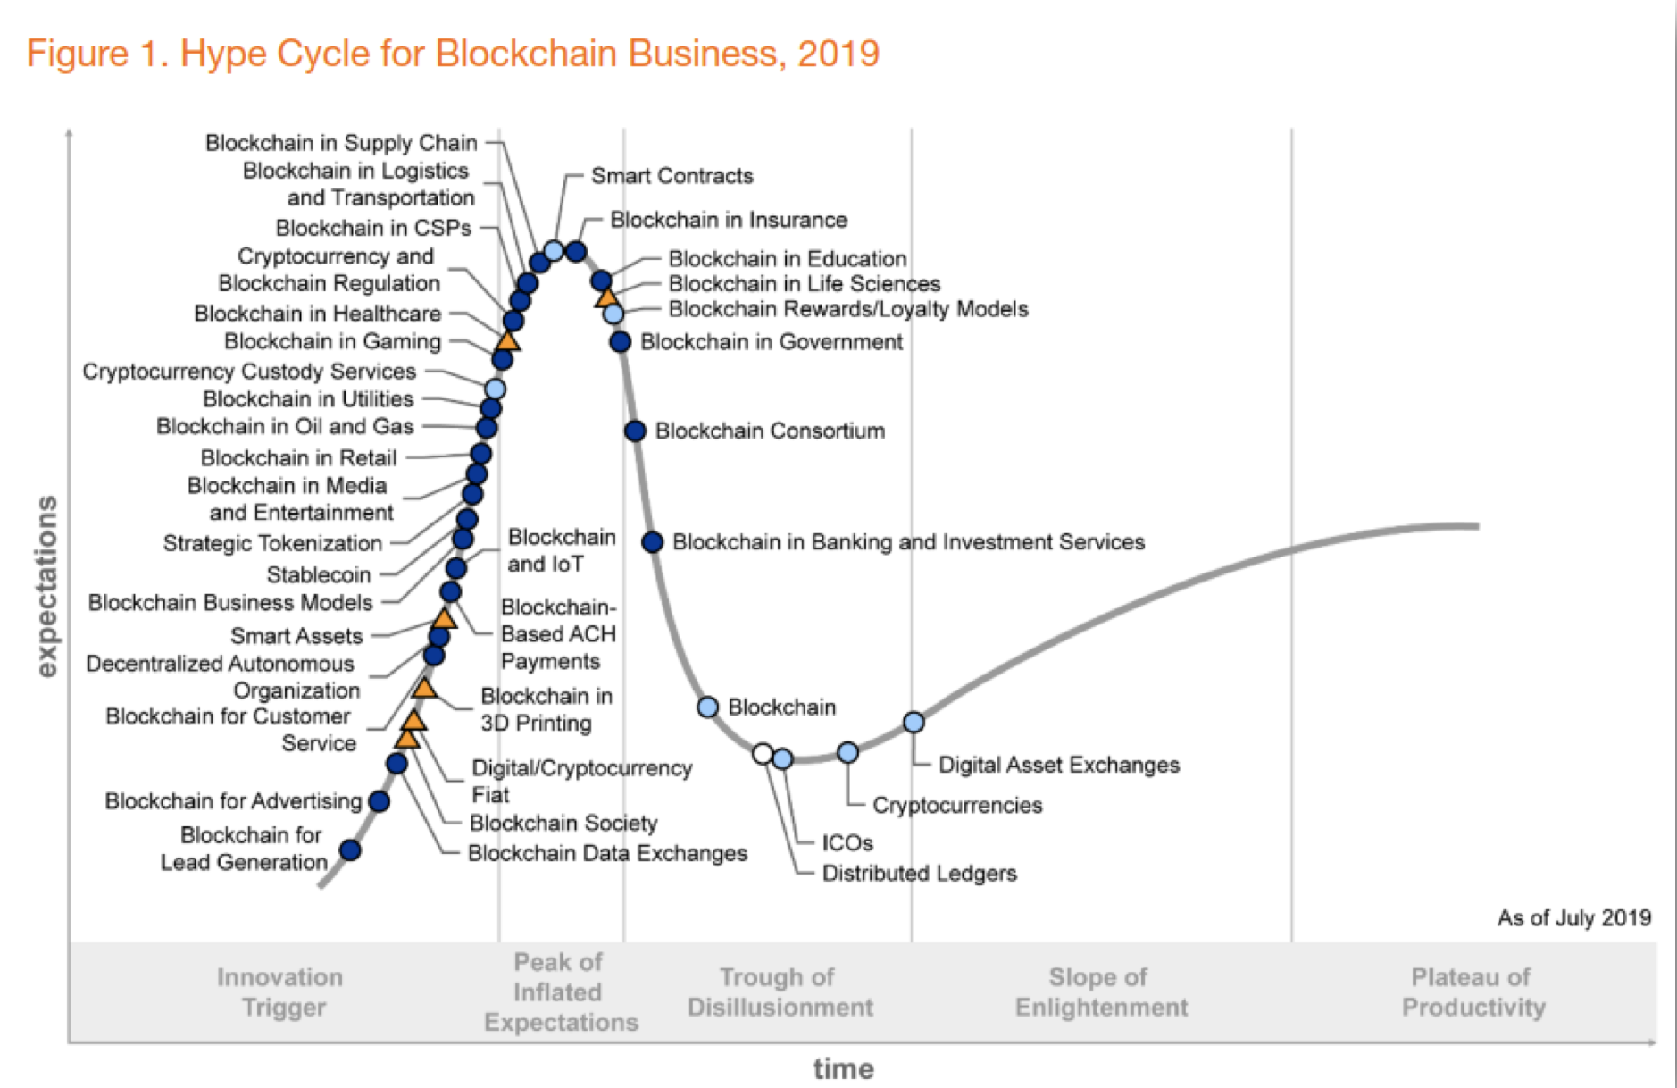
BLOCKCHAIN – FUTURE IMPACT ON TRADE AND SHIPPING
Source: Gartner
Notes:
In G2 Ocean we are committed to being a sustainable, pioneering and responsible company. We will support our owners, Gearbulk and Grieg Star, ongoing commitment to the environment, people and the positive economic impact that a company can have. We want to build on the heritage that both Gearbulk and Grieg Star have and at the same time look at new ways of doing business.
Having only been in operation since May 2017 we have to look at how we can work together with our stakeholders in protecting the environment, ensuring that we treat all those who both work with and for G2 Ocean fairly and responsibly and also ensuring that G2 Ocean will be economically secure for now and the future.
Over the next few months we will be developing our Corporate Social Responsibility policies based on the UN Global Compact principles and ensuring that they are embedded in the way we conduct business and thus our corporate culture.

Slide 11
Central Bank Digital Currencies?

Slide 12
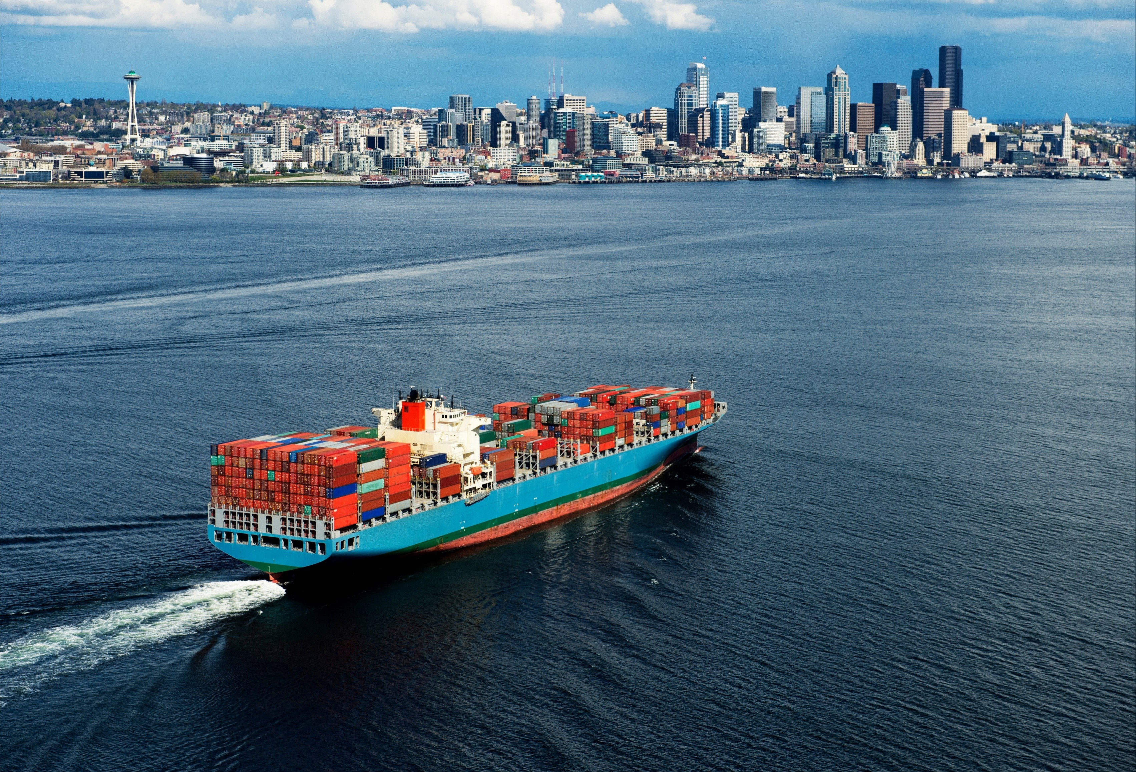
Freight of the future?
Notes:
Money becomes digital
Money becomes programmable
Money becomes traceable for Gov
Venzuela
Ecuador
Tunisia
Senegal
Planlegger:
Dubai, Estland
Russland, Japan
Dubai, Kazakhstan
Sverige
ov.

